Slide 1

Wind Power Generation Analysis
Group 1 JAN23 BDD – Mohsin, Alexandra.

Slide 2
Problem statement
Power generation capacity of renewable energy resources is dependent on weather conditions.
This dependence has created some problem. Key problems are:-
Difficulty to plan for power demand and supply scenarios.
Ensure power system stability as well. Blackouts can occur.
To solve these problems we can use following analysis
Predict power generation based on weather prediction
Analyse old power trends by site
Analyse old weather data by regions
Analyse performance based on wind turbine types/manufacturers.
Analyse fault likelihood and cost per turbine type/manufacturer.

Slide 3
Batch Data Introduction
Our data compromises of four timeseries datasets with a large array of attributes, ranging from 2013-2016.
The timeseries data contains key feature data that we will use a Regression algorithm upon – allowing us to generate predictions. Key features are wind direction, wind speed and outdoor temperature.
We also have a dataset to describe the wind turbines, the faults of each site and a JSON file that allocated each site to each country. This gives us dimensions to work with when analysing the data.
Data of varying types: the timeseries datasets and turbines data are CSV files, the fault and country/site mapping data are JSON files.
For real-time processing, we utilise a weather API, which returns a JSON result.

Slide 4
Data Model
For the non-realtime data, we utilised Hive as a Data Warehouse.
Star Schema best fit our project's scope and capacity - it is better-suited to historical, unchanging data structures which compromises much of our data.
We chose the dimensions of sites, countries, faults and turbines so we can analyse the power generation on a per-site, per-country and per-turbine basis. We can analyse multiple dimensions to determine the most performative turbine – or most reliable turbine.
Galaxy Schema was deemed too complex for the our use case: we do not need to aggregate on different levels of dimension.
Snowflake Schema is a potential alternative given the changeability of the energy industry and changing of requirements, but for the scope of the project and potential future work it didn’t seem necessary.

Slide 5
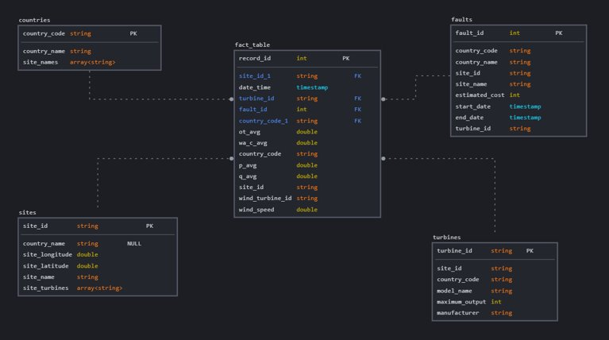

Slide 6
Data Pipeline
A pipeline made of two smaller pipelines, with a joint interaction in the middle.
Pipeline 1: Batch Pipeline.
CSV and JSON files are ingested into HDFS, where they are cleaned and stored in Hive.
We utilise a Regression algorithm to train on the data provided and store the results in Hive.
A Regression algorithm is trained on the batch data to produce a model that is used for predictions in pipeline 2.
Pipeline 2: Real-time Pipeline.
A driver program collects weather API data from an external source, before it is cleaned with Pandas.
We utilise Kafka's publish/consumer model to stream the data before it is utilised to predict power generation. The results are stored in a Hive table with HBase compatibility for use in visualisation.

Slide 7







Data Pipeline (Diagram)
Data is given to ML Model
Batch Data Cleaning
Data warehouse
Training Algorithm
Batch Data
Model is stored for future predictions
Data Ingestion
Prediction using live data
Data warehouse
Transformation/Analysis script
Predictions + Real time data
Real time Data
Weather API

Slide 8

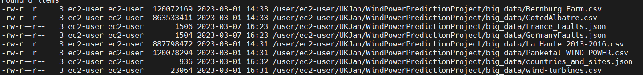
Each of the files are cleaned utilising Pandas or PySpark before being ingested into our Data Lake, Hadoop HDFS.
The data in this project will be given in one, or multiple batches; the historical timeseries data would be ingested periodically, and rarely as it is historic data.
The countries and sites data would be processed periodically, when new sites are implemented into this project's scope.
The faults information is use-case specific. For the purposes of this use case, the files can be thought of as being handed over intermittently or in batches.
Data Ingestion

Slide 9
Data Ingestion
Real-time data comes from WeatherAPI.com.
We query the website's API 4 times per run of the driver script; one for each of the "sites" that we are interested in.
The API returns the result (partially visible to the right) - a lot of data including location, current weather information, future weather information, astrological information (sunrise, sunset).
We only care for temperature, wind speed and wind direction.
The result is returned as a JSON file, and the data is 'clean' and relates to the specification given by the API.
We transform the data through the driver program so it is suitable for purpose.
Transformations include ensuring that data fields are the right type, right unit and that the API returns the correct location name.

Slide 10
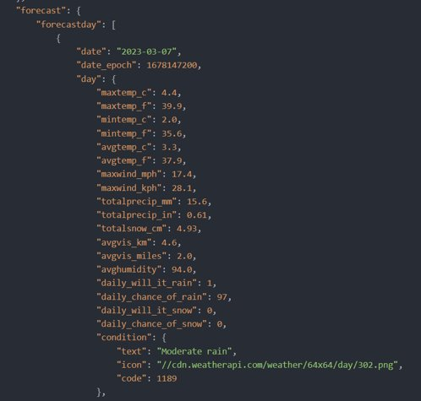
Data Ingestion

Slide 11
Kafka
For our realtime processing we used Kafka. It is quick for writing, and processing.
Our producer is called by our API driver program, and publishes a single row of JSON each time to the consumer.
Our consumer collects the data, and gathers it into a dataframe that can be used for the power prediction algorithm as referred to in our analysis.
We utilised "UTF-8" encoding/decoding as a serialiser/deserialiser.
Kafka allows us to stream a lot of data all at once to be processed when required.

Slide 12
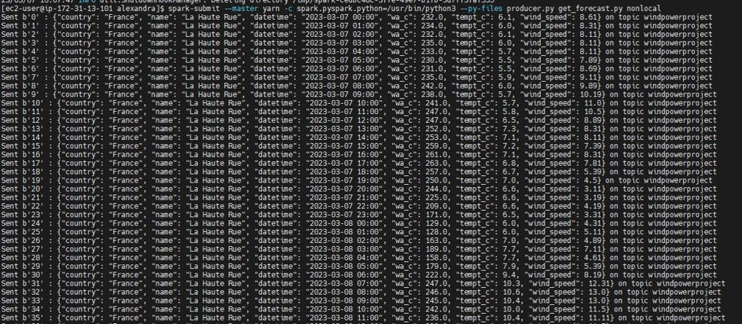

Slide 13
Data Cleaning
The historical data needed to be cleaned for the regression model for the data to be used to accurately visualise much of the data shown in the historical data models.
This includes handling null values, missing values, or mismatch of types – all of which could be potentially present in larger datasets that would be difficult to otherwise showcase.
To remove nulls completely would give incorrect or incomplete data, which could negatively impact the results of the Regression model.
We utilised four cleaning files to clean the data – one for each of the historical datasets as the files that would soon make up the dimension tables were clean.

Slide 14
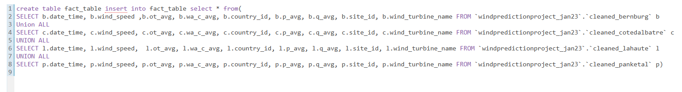
Data Cleaning
The schema for each file was created in PySpark, before we calculated the averages of the numerical values so that we could fill any null numerical values in.
We also checked for non-negative values within the power generation and chose to replace them with 0.
When we had finished cleaning the data, the four databases produced by the files were manipulated in Hive into a single table through the use of the Union functionality.

Slide 15
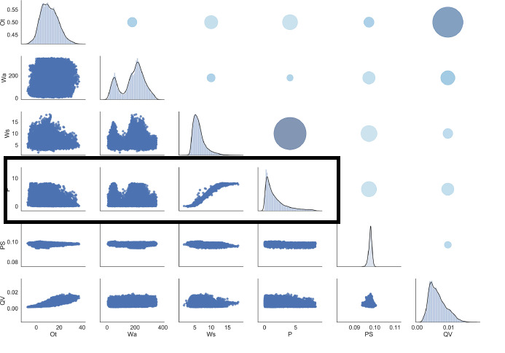
Analysis
We utilised a PySpark library that is often used in predicting future values from past values.
Utilising a library abstracted the 'data scientist' work from ourselves so we could focus on the pipelines, as is our job.
We trained the model using the batch-processed and cleaned historical data, and utilise the realtime API data to make predictions.
80% of the data was used for training, 20% was used to test.
Feature Selection

Slide 16
Model Training
We utilised Spark ML library and RandomForestRegressor()
Data from fact_table is loaded
Datetime column converted to Day of year
Dayofyear, wind_speed, wind_direction and temperature are used to train the regressor model
Trained Model is saved in HDFS
Some studies has used more sophisticated regressors for this purpose.

Slide 17
Realtime prediction and data loading
We utilised Spark ML library and RandomForestRegressor()
Fetch trained model from HDFS
Spark streaming is used
Read stream from kafka
Predict active power using model
Write real time data stream to HDFS (Hive external tables)
Write Predicted data stream to HDFS (Hive external tables)

Slide 18
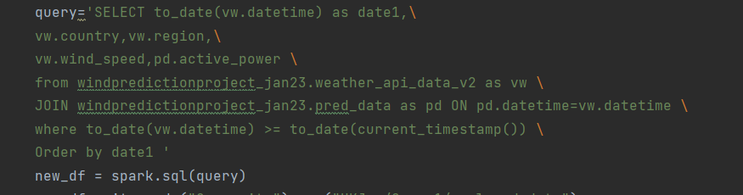
Transformation
We utilised Spark SQL for this
Hive tables are joined to build analysis here
Only future data is fetched from External tables made in last section and joined to obtained wind speed vs active power for all regions countries with datetime stamp.

Slide 19
Data Warehouse for real data
WeatherA-pi_data
datetime
country
region
Wind_speed
Wind_direction
Outside temperature
JOIN
Pred_data
datetime
Active_power
Future data
Analyzed_weather_data
datetime
country
region
Wind_speed
Active_power
(overwritten on every analysis)

Slide 20
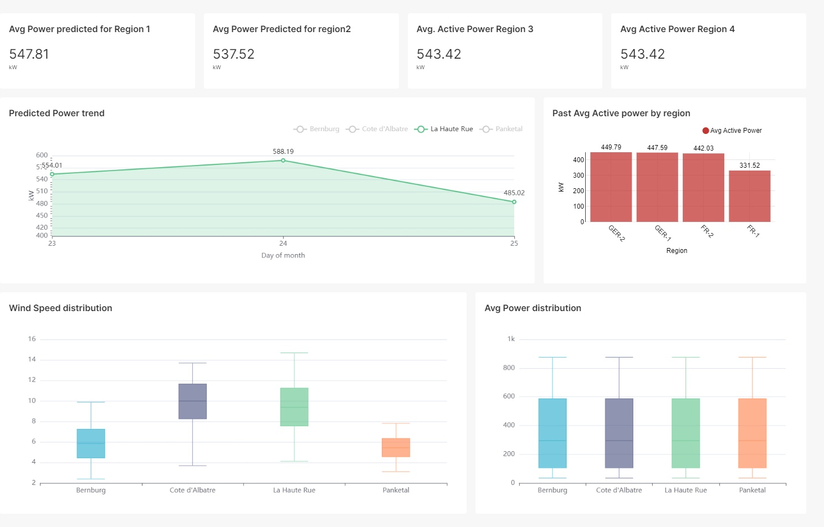
Visualization

Slide 21
Technologies Used
Data Lake
Hadoop HDFS
Data Processing
PySpark (Python, SQL)
Pandas (Realtime Data)
Streaming Data
Kafka
Data Warehouse
Apache Hive
Machine learning Regression algorithm
PySpark
Data Mart
Apache Hive
Visualisation
Superset

Slide 22
Challenges
Controlling and gauging of the scope of the project.
It is easy to have too much or too little data to fit the use case.
Processing JSON in PySpark/Pandas.
Due to having a nested JSON file, we have to investigate the 'explode' SQL function so we could translate it into a Spark Dataframe.
Kafka Implementation.
To ensure we had 1 row of JSON per kafka, we had to use the right to_json() orient. We also converted the JSON to a python dict to iterate properly before dumps.
Working on streaming dataframe
Feature vector assembler was needed but we cannot deassemble it, so we needed two streams to HDFS : one for Real time data and other for prediction on this data.
Cluster Issues
At times the cluster was unreliable and would have faults that created challenges during development for determining if a code works, and testing scenarios where there would periodically be problems in the server that created difficulties in determining if there was a problem in the code or whether it was a server issue.

Slide 23
Alternatives
Spark Streaming
Dask – Pandas alternative
Less features but more power and speed (parallel processing).
Compatible with clusters.
Pandas was performative for the size of API data.
Scala – Language Alternative
A very performative functional programming language.
It was not chosen for this project:
The usage of Pandas for the realtime API was invaluable.
Python is utilised more for machine learning.

Slide 24
Future Work
We can incorporate more dimensions into the databases.
Collecting more data for the faults, and for other sites and countries would create a more robust and useful service that more adequately aligns with our use case.
Training the machine learning algorithm on more data can help us achieve a better accuracy. For the sake of the project, the accuracy.

